Slide 1
Energy Aware Real Time Systems
Acknowledgments:
Gathala Sudha Anil Kumar
Ki-Sung Koo
(former TAs)
CprE 458/558: Real-Time Systems (G. Manimaran)

Slide 2
Introduction
Energy consumption is an important issue in embedded systems.
  Mobile and portable devices, laptops
  Mobile and Intelligent systems: Digital camcorders, cellular phones, and portable medical devices.
  Sensor network applications
CprE 458/558: Real-Time Systems (G. Manimaran)

Slide 3

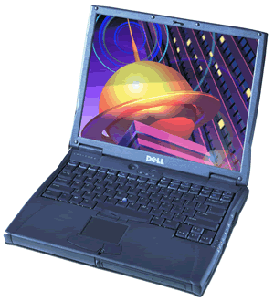
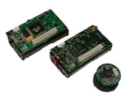
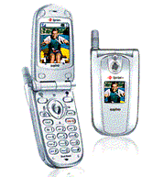
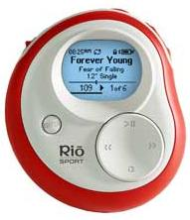
Introduction
Embedded devices play prominent roles in a variety of applications
  medical sensors in human body.
  Signaling sensors in war fields.
A typical networked embedded system consists of:
  Computing subsystem -- driven by an embedded processor operated by a RTOS.
  Communication subsystem -- consists of a radio chipset driven by a firmware.
A typical Embedded System
Battery
Computing Subsystem
(Driven by RTOS)
Communication Subsystem
(Driven by Firmware)
Micorprocessor, Digital Signal Processor (DSP)
Radio, RF amplifiers, A-to-D & D-to-A ckts

Slide 4
Important Facts (1)
The peak computing rate needed is much higher than the average throughput that must be sustained;
High performance is needed only for a small fraction of time, while for the rest of time, a low-performance, a low-power processor would suffice.
CprE 458/558: Real-Time Systems (G. Manimaran)

Slide 5
Workload Profile
Peak Computing Rate is needed
Work load
Average rate would suffice
Time
CprE 458/558: Real-Time Systems (G. Manimaran)

Slide 6
Important Facts (2)
Processors are based on CMOS logic
-- Static power + Dynamic power
Dynamic power (due to switching activity)
P α V² . f
V α f V: voltage; P: power; E: Energy
E = P * Tcc Tcc = CC/f
E_{i} = K .cc_{i} . f²
Where Tcc : execution time;
CC_{i} : # clock cycles of task T_{i.}
f : frequency at which T_{i} is run.
CprE 458/558: Real-Time Systems (G. Manimaran)

Slide 7
Variable Voltage Processors
Modern processors operate at multiple frequency levels.
  Qualcomm Snapdragon Family (Powering numerous Android devices)
  Apple A7 processor (Powering all iPhone 5S)
  Intel Haswell Processors (all latest laptops)
Higher the frequency level higher the energy consumption
CprE 458/558: Real-Time Systems (G. Manimaran)

Slide 8
Case study (iPhone 5S)
iPhone 5’s power management system
Computation System
(operated by RTOS)
Computation System
(operated by Firmware)
Multiprocessor (A6)
Memories
RF Modem
Power amplifier
Power management ICs
Battery
3.8V - 5.45Wh
1440mAh
DC/DC down converter
LDO (Low Drop Out)
Why we need these?
Internal elements needs various types of voltages.
-. DC/DC converter provides large capacity power.
-. LDO provides small capacity power.
CprE 458/558: Real-Time Systems (G. Manimaran)

Slide 9
Case study (smart phones)
Practical multi-core processors
Contemporary multi-core processors have more than 2 cores at about 1 GHz.
Device | Chip maker | Processor name | Frequency | # cores
iPhone 5 | Apple | A6 | 1.02GHz | 2
Galaxy S III | Samsung | Exynos 4412 | 1.44GHz | 4
Motorola RAZR | Ti | OMAP 4430 | 1.2GHz | 2
HTC one S | Qualcomm | MSM8260A | 1.2GHz | 2
Asus transformer | NVIDIA | Tegra 3 | 1.3GHz | 4
New iPad | Apple | A5X | 1 GHz | 2
CprE 458/558: Real-Time Systems (G. Manimaran)

Slide 10
Case study (smart phones)
Multimedia parts (ARM core, power regulators, LCD, camera, etc.) are the major part of power consumption when a wireless embedded system does not work for communication.
RX power amplifier, RF module will also critical when the system work for wireless communication.

Slide 11
Energy-aware Real-Time Systems
There will be three main types of power management techniques.
DVFS (Dynamic Voltage & Frequency Scaling)
DMS (Dynamic Modulation Scaling)
Network Coding

Slide 12
Dynamic Voltage Scaling (DVS)
DVS scales the operating voltage of the processor along with the frequency.
Since energy is proportional to f² , DVS can potentially provide significant energy savings through frequency and voltage scaling.
CprE 458/558: Real-Time Systems (G. Manimaran)

Slide 13
Simple DVS-Scheme
DVS
Task queue
Next task
Over loaded
f = F
system
Under loaded
f = F/2
CprE 458/558: Real-Time Systems (G. Manimaran)

Slide 14
DVS-example
Consider a task with a computation time 20 units.
Energy of T_{i} without DVS:
  E1 = K * 20 * F^{2.}
Energy of T_{i} with DVS:
  E2 = K * 20 * (F/2)^{2.}
Clearly, E2 = (E1)/4
Time taken = t1 (say)
Time taken = t2 = 2 * t1
Therefore, if we reduce the frequency we save energy but, we spend more time in performing the same computation
CprE 458/558: Real-Time Systems (G. Manimaran)

Slide 15
Energy-Time Tradeoffs
60
40
Energy
Savings
20
10
Time
CprE 458/558: Real-Time Systems (G. Manimaran)

Slide 16
Case study (simple power scheduling)
A brief flow chart of power scheduling
Computation System
(off-line operation)
Communication System
(on-line operation)
Power-on
Start-up
Three types of call modes
Communication
off / on
High power
mode
Idle mode
High freq. & low vtg.
Medium power
mode
Low power
mode
Sleep mode
Active mode
Low freq. & low vtg.
High freq. & high vtg.
*For DVS, there are low & high frequency clocks . DC converter and LDO provide various types of voltages.
*Low /medium/high power mode is decided by antenna condition.
CprE 458/558: Real-Time Systems (G. Manimaran)

Slide 17
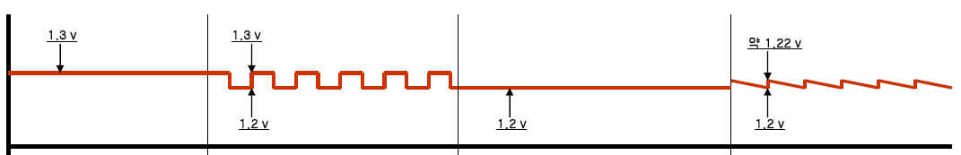
Case study (DVS, Dynamic Voltage Scaling)
An example of DVS for processor’ core.
voltage
Time
High CPU
Semi-low CPU
Low CPU
Sleep mode
High frequency
Semi-low frequency
Low frequency
Active mode
Idle mode
*There are various DVS scenarios for power saving in order to save average power consumption. Core voltage of processors is supplied by system applications.
CprE 458/558: Real-Time Systems (G. Manimaran)

Slide 18
Power Consumption of DVFS
Implemented in Android-based device, Google Nexus S

Slide 19
Nexus S Processor Specs
Running Android 4.1.2 Jelly Bean OS.
ARM Cortex A8 Hummingbird Processor
  Supports dynamic frequency scaling from 100Mhz to 1Ghz
  Supports voltage scaling from 800mV to 1500mV
Supported frequencies along with their predefined voltage of operation are as follows –
  100Mhz -> 950mV
  200Mhz -> 950mV
  400Mhz -> 1050mV
  800Mhz -> 1200mV
  1000Mhz -> 1250mV

Slide 20
Implementation of DVFS
Android-based kernels were used to implement task schedulers and CPU governors that are the 2 important factors that contribute to deciding the performance and power consumption in an Android-based device.
Before moving ahead, it is important to know the different configurations of CPU governors and task schedulers with respect to the Android Operating System.

Slide 21
Implementation of DVFS
Implemented using Linux kernels which support multiple CPU governors and schedulers.
CPU governor -> Decides how to scale the frequency of the processor based on the workload.
Scheduler -> Gives tasks access to resources at the time of execution

Slide 22
CPU Governors
There are numerous CPU governors that can be included in kernels.
  Ondemand
  Conservative
  Performance
  Interactive
  Powersave
  Min-Max

Slide 23
Schedulers
The different linux-based schedulers that are frequently implemented in Android are –
  Complete Fair Scheduler (CFS)
  No-Op Scheduler
  Deadline Scheduler
  ….

Slide 24
Compiling the Kernel
Environment -> Ubuntu Linux 12.04.
It involved forking off kernel code from github.com and running pre-defined steps to complete the compilation.
Schedulers and CPU governors can be added and removed as required at the time of compilation.

Slide 25
Tool for changing various parameters
NSTools and setCPU, both applications available on the Google Play Store, can be used to change various parameters on the phone -> CPU’s maximum and minimum frequency, governor and scheduler.
Manipulating with the voltage of operation can be done by “echo”ing values directly to the following file –
/sys/devices/system/cpu/cpu0/cpufreq/UV_mV_table
Similar echoing of values can be done to change the maximum and minimum operating frequencies of the CPU as well.

Slide 26
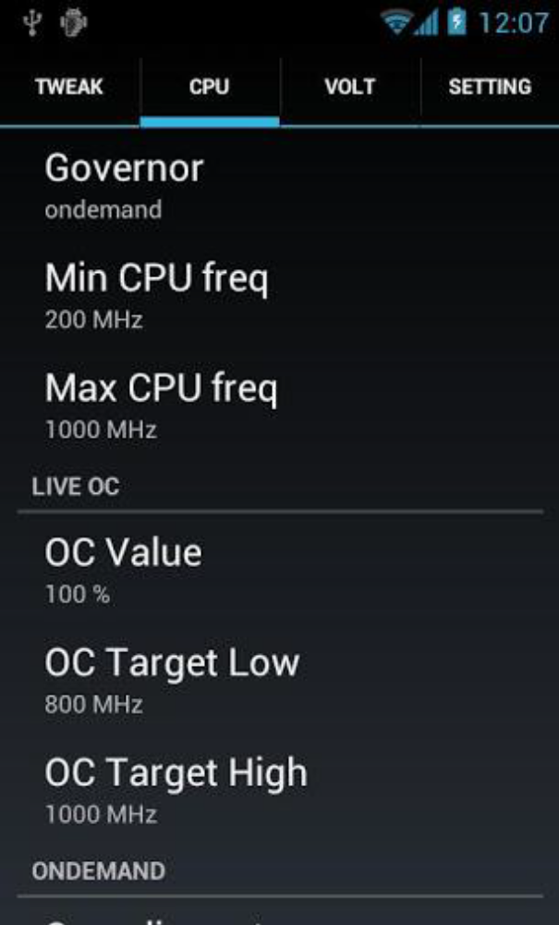
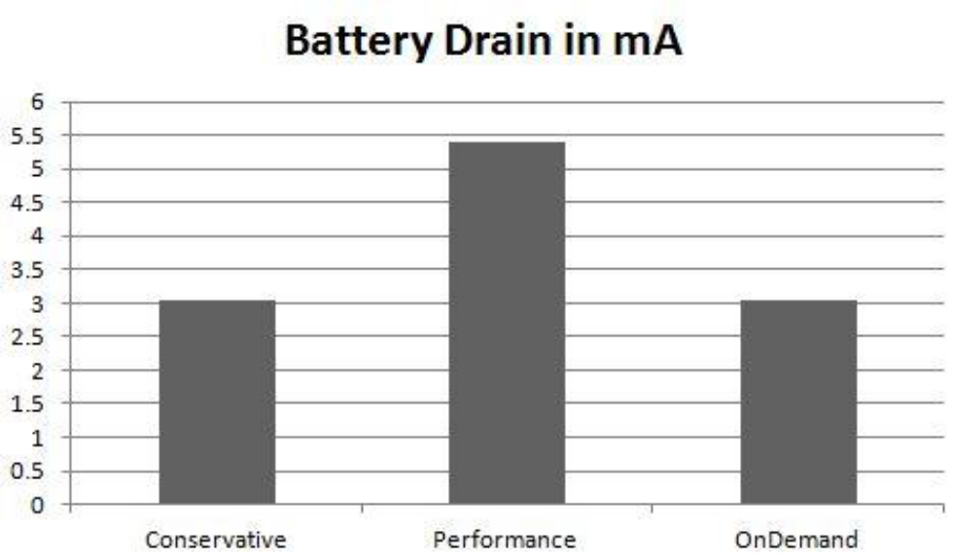
Tool for changing various parameters
CprE 458/558: Real-Time Systems (G. Manimaran)

Slide 27


Slide 28
References
Power reduction techniques for microprocessor systems Vasanth Venkatachalam, Michael Franz , ACM Computing Surveys (CSUR), Volume 37 Issue 3 , Sept. 2005.
Power management for energy-aware communication systems, ACM Transactions on Embedded Computing Systems (TECS), Volume 2 , Issue 3 (August 2003) , Pages: 431 - 447
[1] Real-Time Dynamic voltage scaling for Low-Power Embedded Operating Systems, P. Pillai and K. G. Shin, in ACM SOSP, pages 89-201, 2001.
[2] Intra-task Voltage Scheduling on DVS-Enabled Hard Real-Time Systems, D. Shin and J. kim, IEEE Design and Test of Computers, March 2001.
[3] Enhanced fixed-priority scheduling with (m,k)-firm guarantee, G. Quan and X. ( Sharon ) Hu IEEE Real-Time Systems Symposium, pp 79-88, 2000.
CprE 458/558: Real-Time Systems (G. Manimaran)

